Slide 1

HOUSING PROPERTY DATA MANAGEMENT
BY:- MEHTAB ALAM WARSI

Slide 2

Project Overview:
A "Housing Property Data Management Project" focuses on creating a centralized system or database for efficiently collecting, storing, managing, and retrieving data related to housing properties.
This project is useful for real estate agencies. It is typically designed to help various stakeholders, including homebuyers, sellers, real estate professionals, and policymakers, make informed decisions related to the housing market.

Slide 3

Purpose
The ultimate purpose of this project is to create a comprehensive data management solution that aids in the efficient management of housing properties, enhances client interactions, and enables professionals in the real estate and property management industry to provide better services and make informed decisions.

Slide 4

Process Involved in Data Analysis.
Data collection/extraction
Data cleaning/preprocessing
Data exploration into SQL
Data Loading
Data visualization

Slide 5

DATA SOURCE
Property Details
Maintenance Records
Property Listings
Market Data

Slide 6

AIM OF THE PROJECT
To acquire data from various sources such as external sources: property details, property listings, market data and some internal sources and collate it into single database.
This can help in identifying trends and patterns, stakeholders can make more informed decisions, improve operational efficiency, and enhance client satisfaction.

Slide 7
The scope of the "Housing Property Data Management Project" is to ensure:
Efficient Data Handling
Data-Driven Decision-Making
Enhanced Client Interactions
Data Accessibility

Slide 8

DATA COLLECTION/EXTRACTION
Getting Email From Sales Team of REAL ESTATE Consultants
Downloading & Importing Master Data in csv format from Email into Excel File.
Ensure the data is accurate, complete, and representative of the problem.

Slide 9
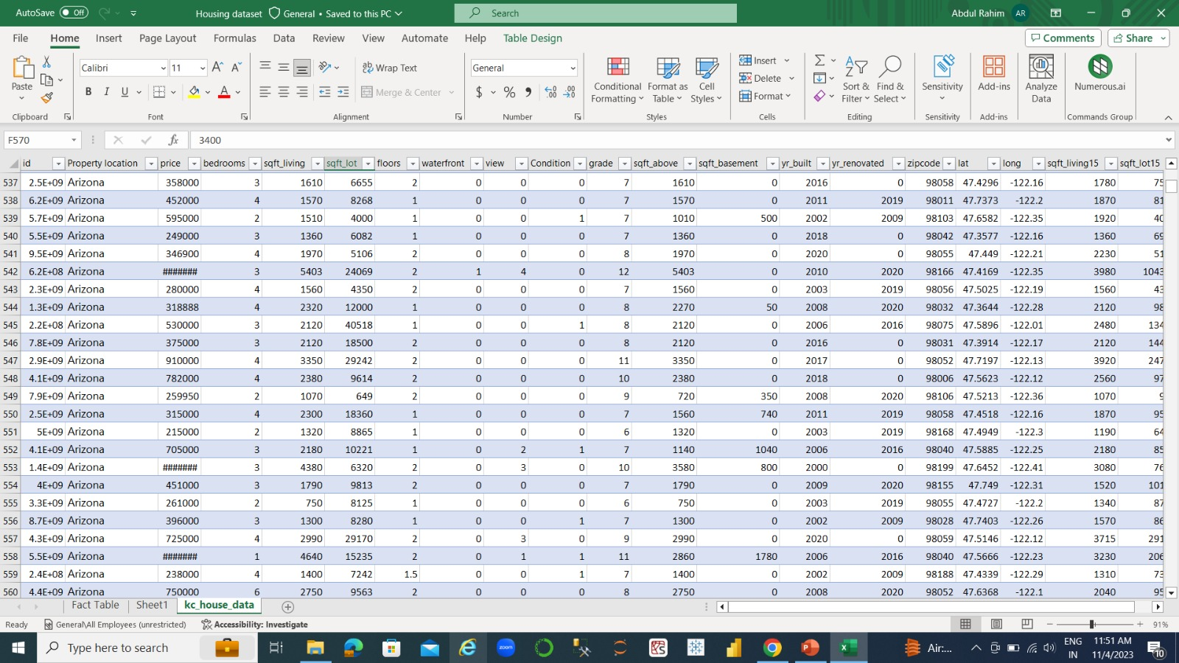
RAW MASTER DATA

Slide 10
DATA CLEANING/DATA PREPROCESSING
Now in Excel using Power Query we are Cleaning and Preprocessing the data to remove errors, inconsistencies, handling missing values, finding null values and outliers to ensure that it is accurate, reliable, and suitable for analysis.
This step is crucial for ensuring the quality of your analysis.
Removed columns which are irrelevant.
Preparing datasets, adding columns to the master data.
Waterfront columns value changing value of 0 & 1 to Yes or No.
Checking data types of each columns and changing it.
Renaming the column names.
For condition column changing value of 0,1,2 to Very Good, Good & Bad.

Slide 11

Data Exploration into SQL
Importing our cleaned and structured Dataset into DATABASE MICROSOFT SQL for doing Query through Analysis, more data cleaning and validation.
Performing SQL queries on the loaded Database…..
So basically we will now query the data according to our requirements, below are some examples:

Slide 12
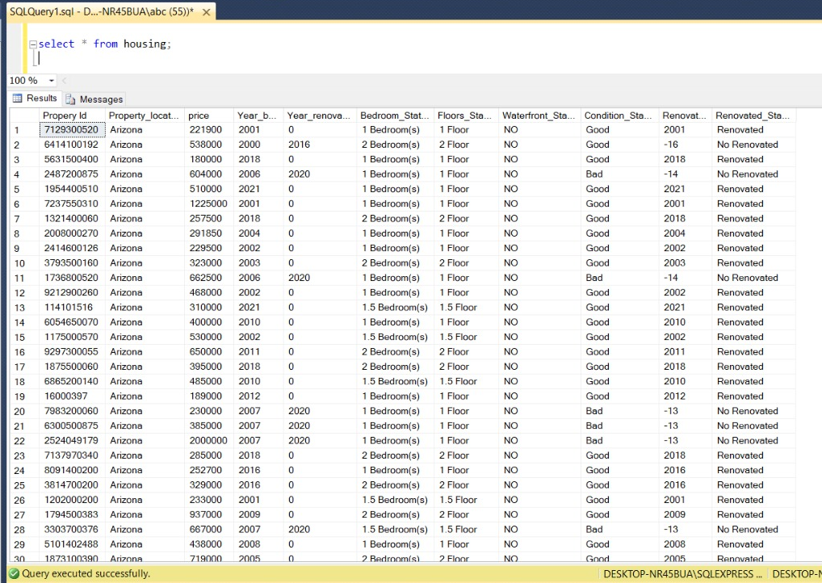
HOUSING PROPERTY STRUCTURED AND CLEANED DATASET

Slide 13
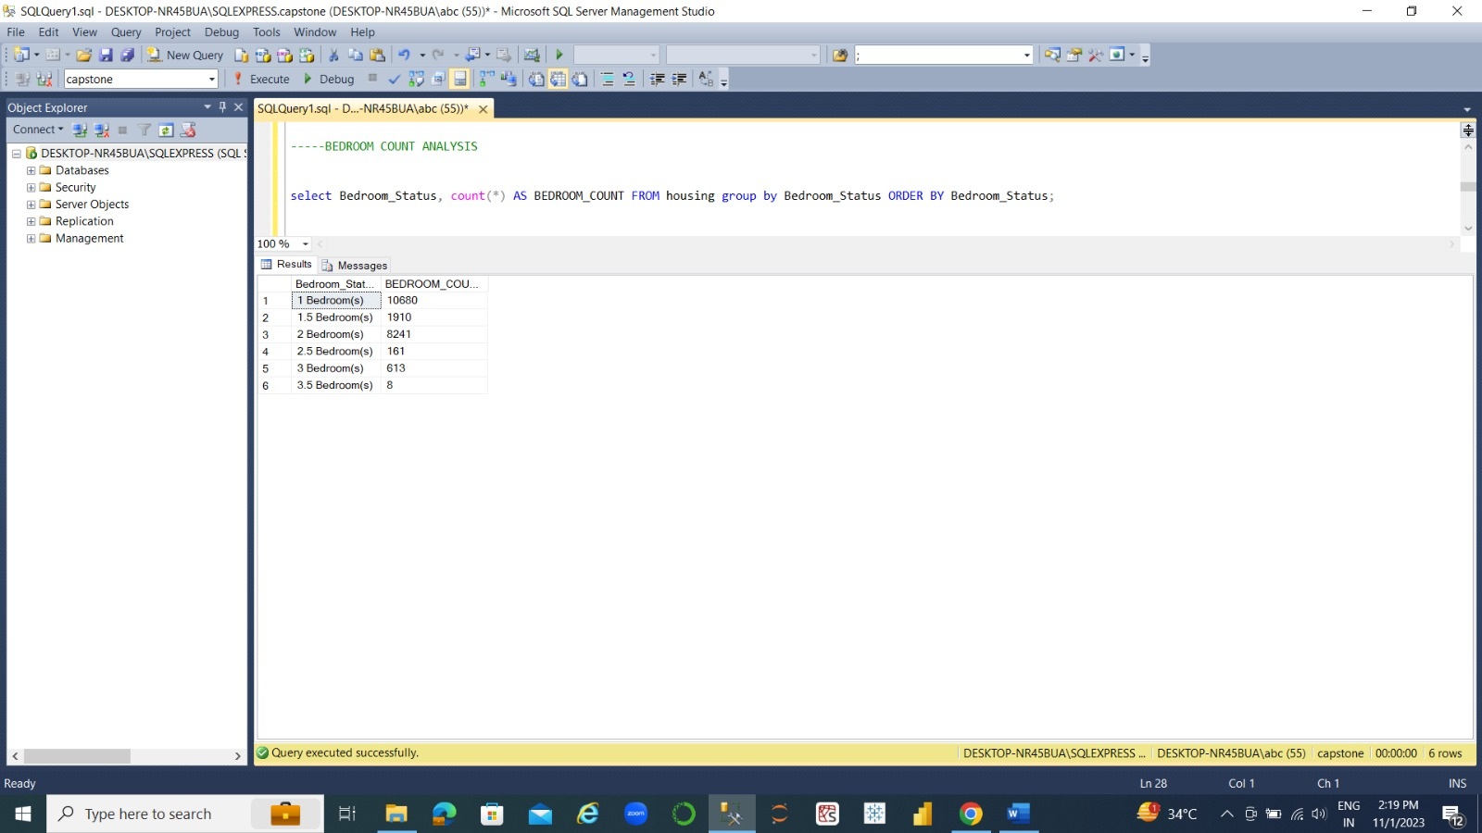
-----BEDROOM COUNT ANALYSIS
select Bedroom_Status, count(*) AS BEDROOM_COUNT FROM housing group by Bedroom_Status ORDER BY Bedroom_Status;

Slide 14
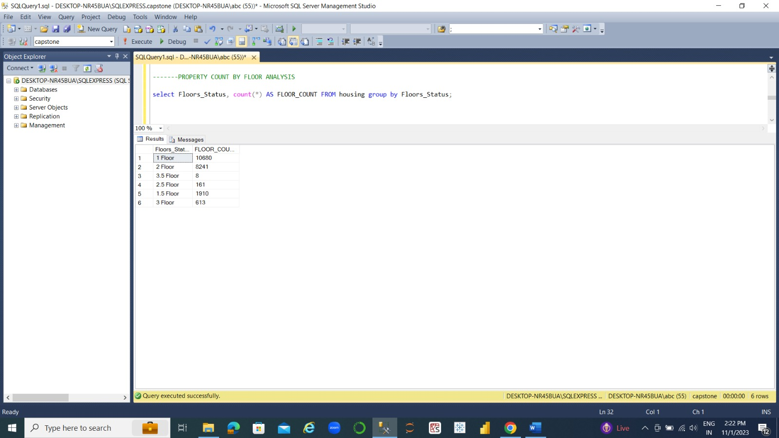
(2)------PROPERTY COUNT BY FLOOR ANALYSIS select Floors_Status, count(*) AS FLOOR_COUNT FROM housing group by Floors_Status;

Slide 15
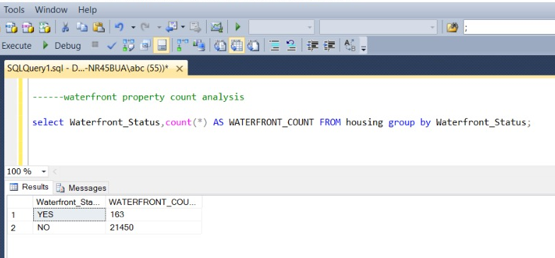
(3)------waterfront property count analysis select Waterfront_Status,count(*) AS WATERFRONT_COUNT FROM housing group by Waterfront_Status;

Slide 16

(4)-----properties which are renovated or not select Renovated_Status,count(*) AS RENOVATED_COUNT FROM housing group by Renovated_Status;

Slide 17
(5)------PROPERTY CONDITION ANALYSIS SELECT Condition_Status, count(*) AS CONDITION_COUNT from housing group by Condition_Status;

Slide 18
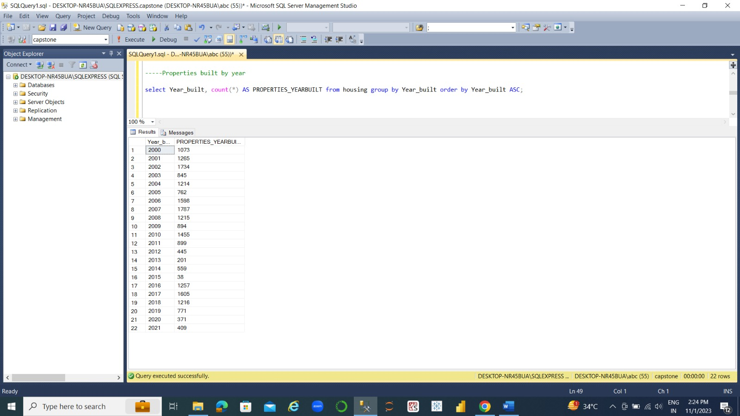
(6)-----Properties built by year select Year_built, count(*) AS PROPERTIES_YEARBUILT from housing group by Year_built order by Year_built ASC;

Slide 19
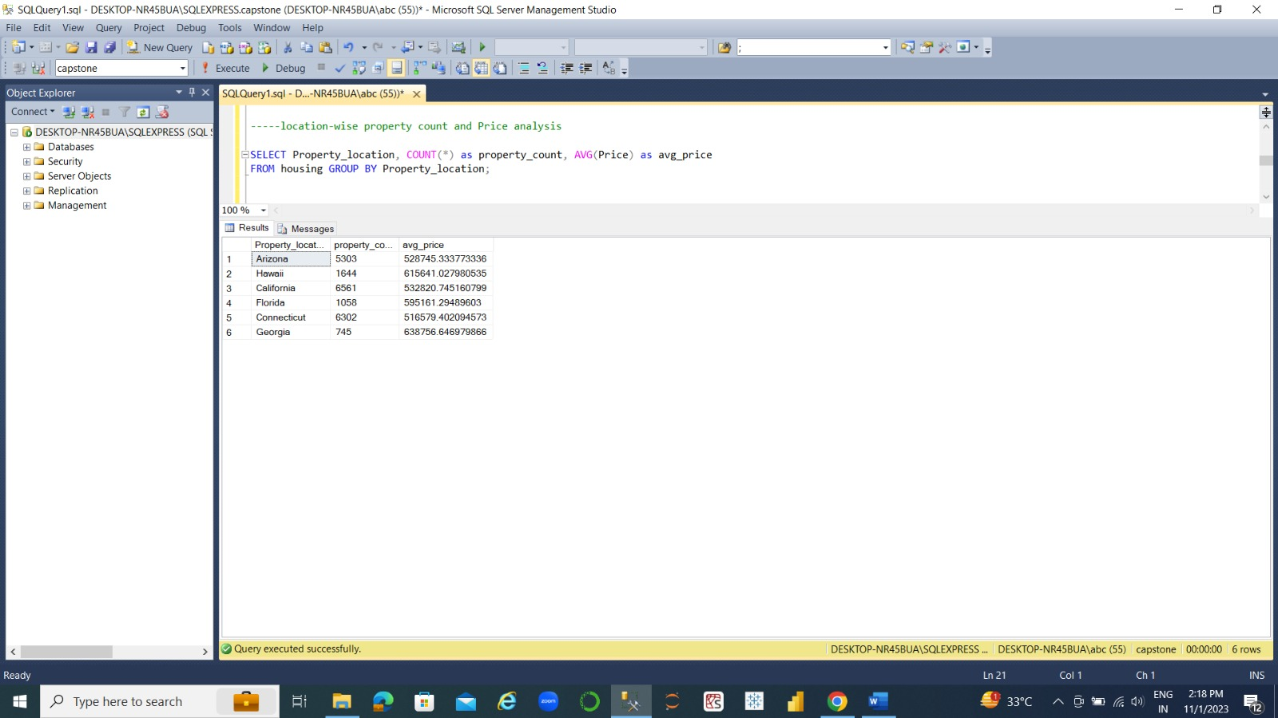
(7)-----location-wise property count and Price analysis SELECT Property_location, COUNT(*) as property_count, AVG(Price) as avg_price FROM housing GROUP BY Property_location;

Slide 20

(8)---KPI AVERAGE PROPERTY AGE SELECT AVG(2023 - Year_built) AS avg_property_age from housing;

Slide 21
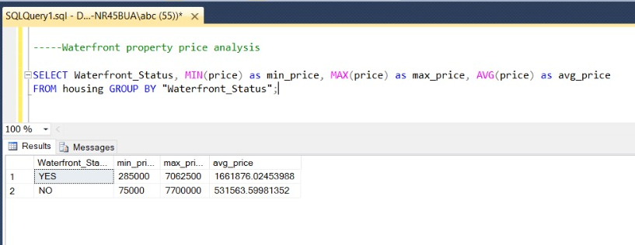
(9)-----Waterfront property price analysis SELECT Waterfront_Status, MIN(price) as min_price, MAX(price) as max_price, AVG(price) as avg_price FROM housing GROUP BY "Waterfront_Status";

Slide 22
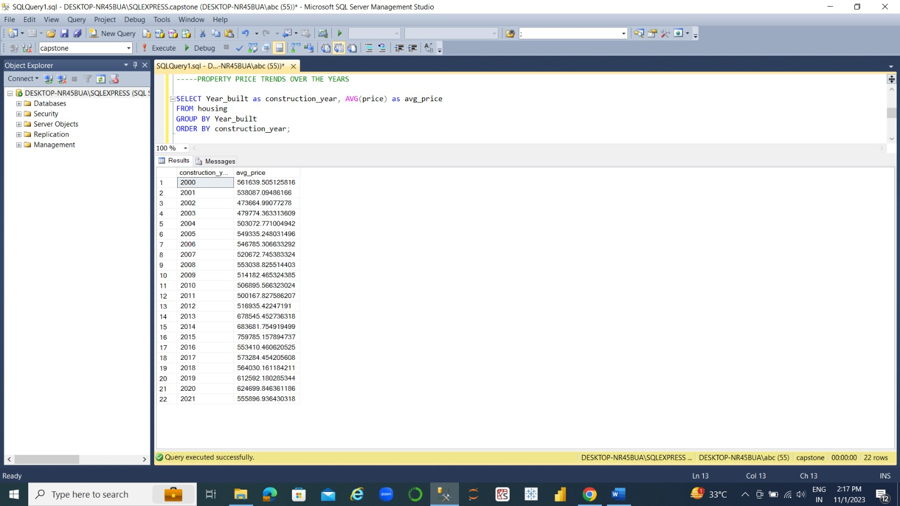
(10)-----PROPERTY PRICE TRENDS OVER THE YEARS SELECT Year_built as construction_year, AVG(price) as avg_price FROM housing GROUP BY Year_built ORDER BY construction_year;

Slide 23
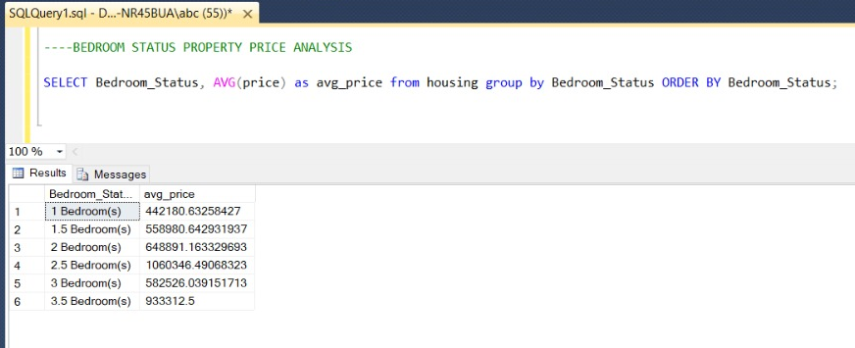
(11)----BEDROOM STATUS PROPERTY PRICE ANALYSIS SELECT Bedroom_Status, AVG(price) as avg_price from housing group by Bedroom_Status ORDER BY Bedroom_Status;

Slide 24

(12)-----KPI AVERAGE PROPERTY PRICE select AVG(price) as AVG_PRICE from housing;

Slide 25
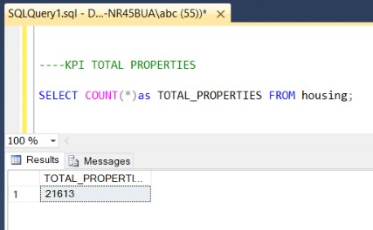
(13)----KPI TOTAL PROPERTIES SELECT COUNT(*)as TOTAL_PROPERTIES FROM housing;

Slide 26

DATA LOADING
After the data is transformed in SQL Server it is loaded into an Excel spreadsheet. Excel serves as an intermediary storage for the prepared data before it is used for visualization in Tableau.

Slide 27

DATA VISUALIZATION
Using Tableau, the loaded data is then visualized in a worksheet. Tableau allows you to create interactive and informative visualizations based on the transformed data.
This process is crucial for converting raw data into actionable insights and presenting them effectively through visualizations.

Slide 28

Tableau Visualizations
In order to visualize data to draw the important insights from it regarding potential business opportunities and target areas so that we can take important decisions such as:
To provide a user-friendly platform that simplifies property listings, tenant management, and maintenance tracking, enhancing the overall property management process.
Identify trends in property values over time, helping stakeholders understand how property values are changing in different locations and property types.
Understand which property features are most in demand and how property grading affects property values.
Identify maintenance and repair trends, helping property managers schedule and plan property upkeep more effectively.
Tableau can be used to connect to any type of file. In this case we would be connecting to any excel file and our analysis would be based on historical data rather than live data.

Slide 29
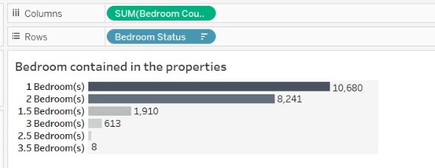
Here in this stacked bar chart, we are analyzing the count of types of properties we have in our data. The majority of properties are 1 and 2 bedrooms, with a significant number of 1.5 and 3 bedrooms.

Slide 30
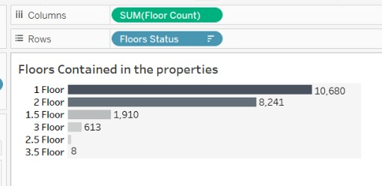
Here in this stacked bar chart, we are analyzing the Floors contained in the properties. Most properties have 1 or 2 floors, with a smaller number having 3 floors.

Slide 31
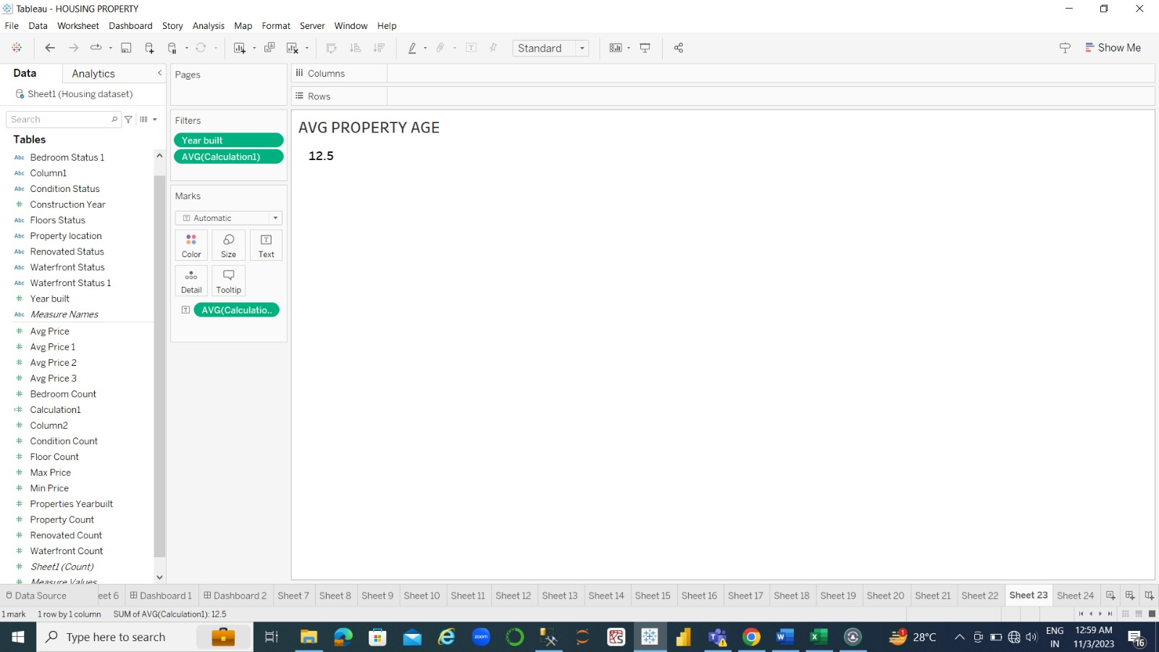
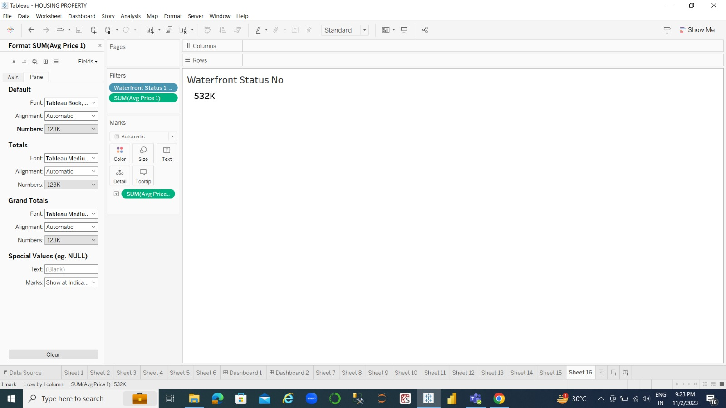


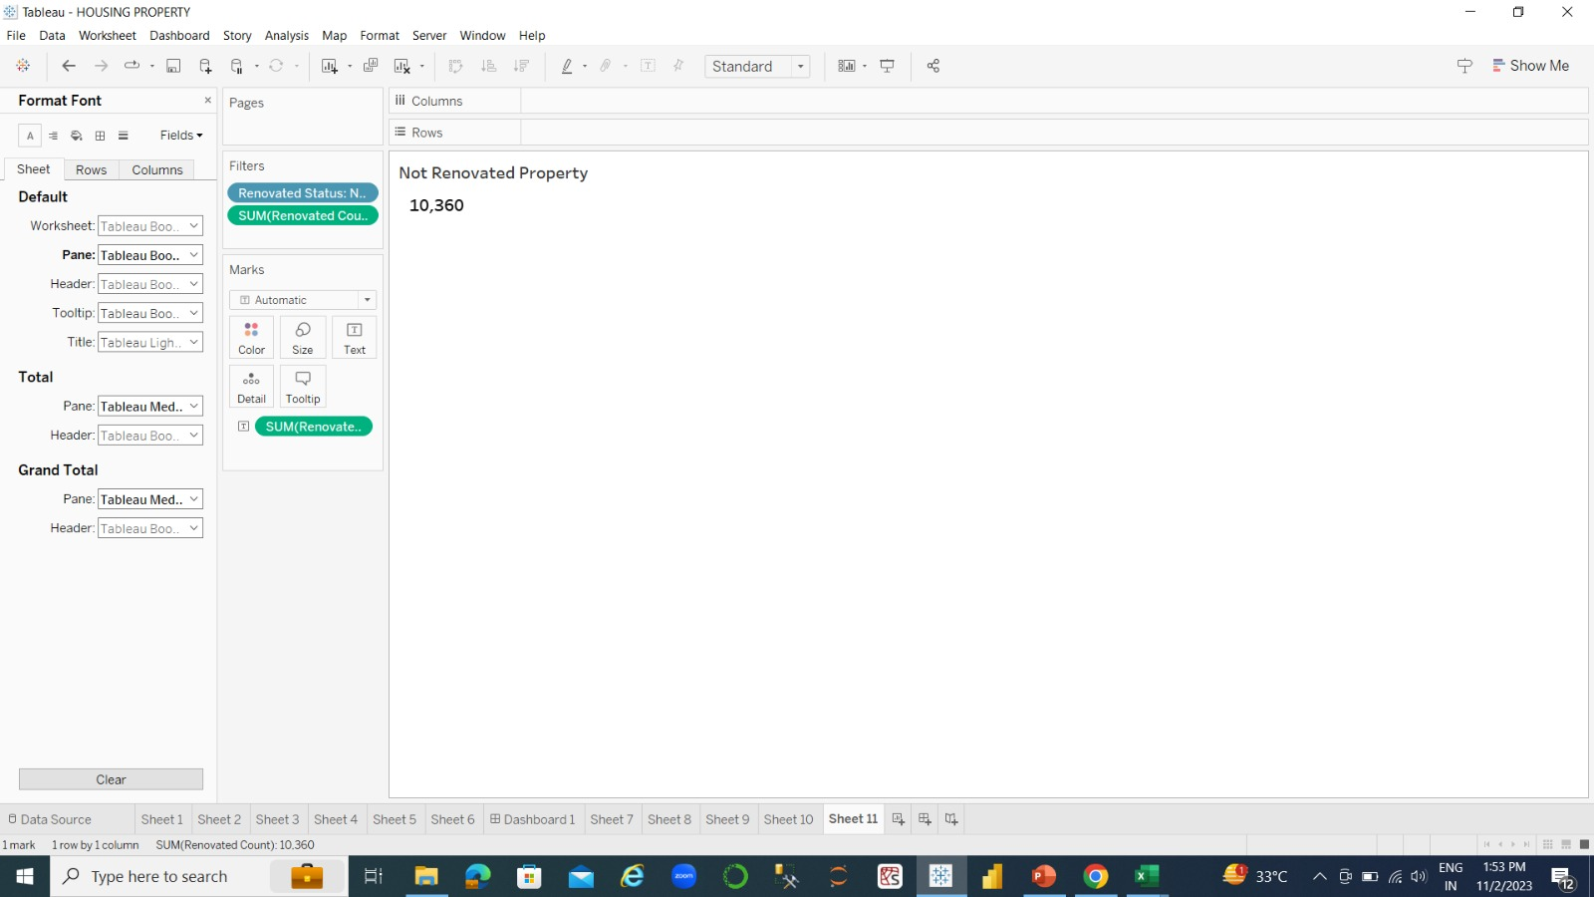
Here we are highlighting KPI’s:

Slide 32
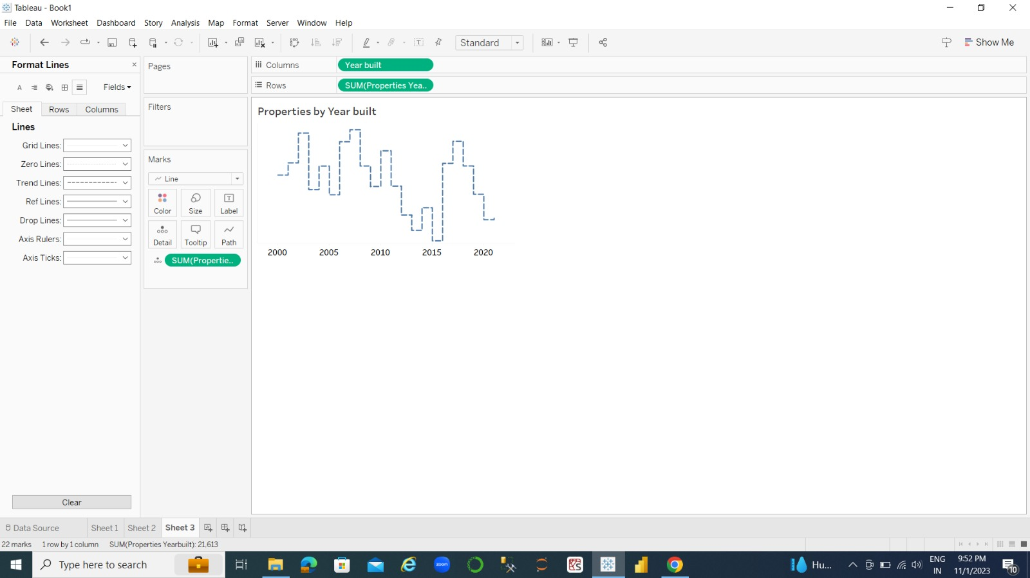
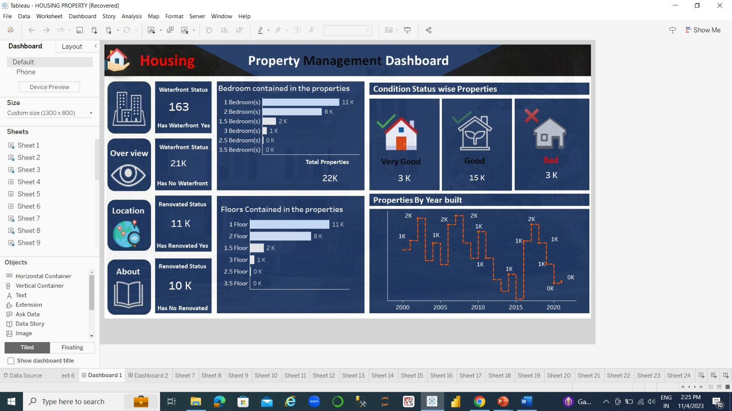
In this dual combination, we are analyzing properties built over the years. Properties were primarily built in the 2000s and 2010s, with a few exceptions in the 2017 and 2018. There's a need for a focus on newer properties as construction declined in recent years.

Slide 33
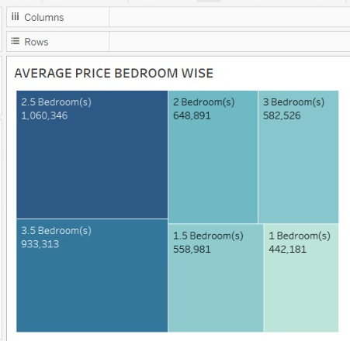
In this tree maps, we are representing prices according to bedrooms. Properties with 2.5 bedrooms have the highest average price. Pricing varies based on the number of bedrooms.

Slide 34
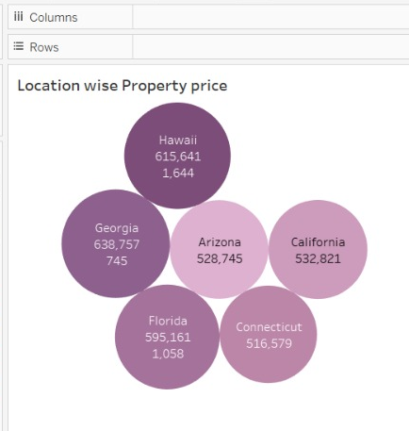
In this packed bubbles chart, we are analyzing the location wise price of properties. Property prices vary by location, with Georgia and Hawaii having higher average prices. Location plays a crucial role in property pricing.

Slide 35
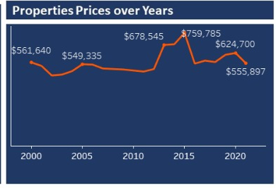
In this line graph we are analyzing the most important point like Price of the properties change over the Years. Property prices have fluctuated over the years, with potential investment opportunities in specific years.

Slide 36


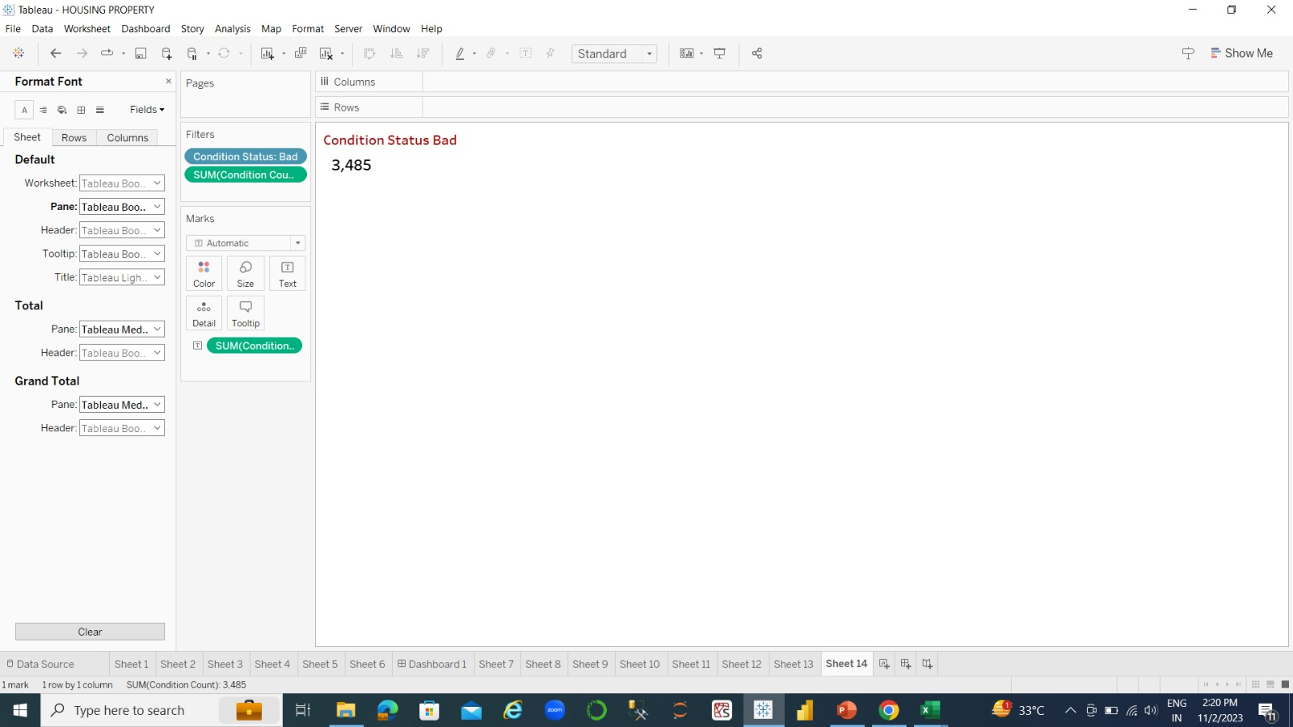

Some more KPI’s:

Slide 37
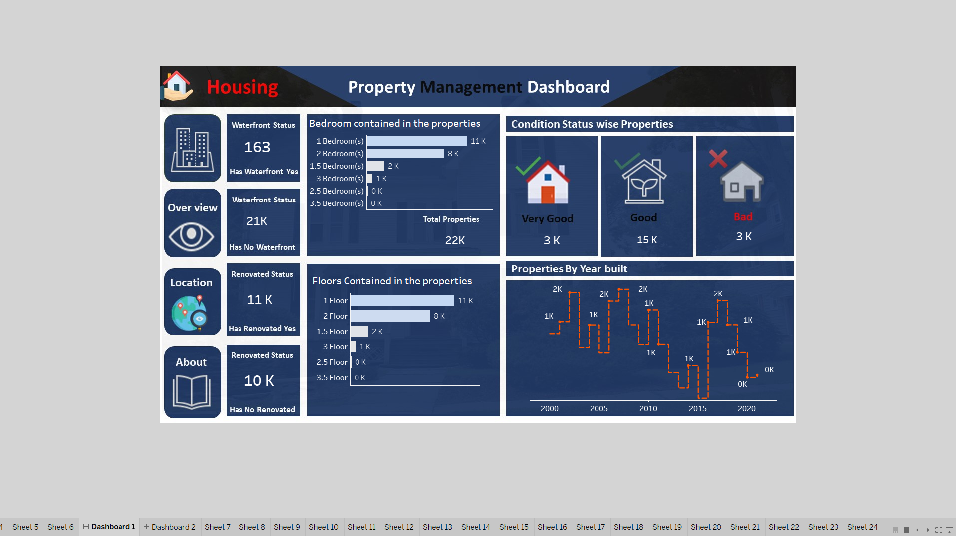

Slide 38


Slide 39
CONCLUSION
The "Housing Property Data Management Project" has culminated in a series of key insights and outcomes that are poised to transform the housing and real estate industry.
These insights underscore the significance of efficient data management, data-driven decision-making, and enhanced client interactions: It underscores the evolving role of data as a strategic asset, supporting not only efficient management but also informed decision-making and superior client service.
The insights and outcomes derived from this project reflect a future where data is the driving force behind property management success.

Slide 40
INSIGHTS
Based on the insights derived from the dashboards for the "Housing Property Data Management" project, here are some key conclusions for decision making:
Property Distribution:
The majority of properties are 1 and 2 bedrooms, with a significant number of 1.5 and 3 bedrooms.
Most properties have 1 or 2 floors, with a smaller number having 3 floors.

Slide 41
Condition of Properties:
Good condition properties dominate, with a significant number of very good condition properties.
Year Built:
Properties were primarily built in the 2000s and 2010s, with a few exceptions in the 2017 and 2018.
There's a need for a focus on newer properties as construction declined in recent years.
Waterfront Properties:
A limited number of properties are waterfront, while the majority are not waterfront.

Slide 42
Renovation Status: A substantial number of properties have been renovated, suggesting a market for renovated homes. Location-wise Insights: Property prices vary by location, with Georgia and Hawaii having higher average prices. Location plays a crucial role in property pricing. Bedroom-wise Analysis: Properties with 2.5 bedrooms have the highest average price. Pricing varies based on the number of bedrooms. Average Property Age: The average property age is 12.5 years, indicating a relatively newer property market.

Slide 43
Price Insights: The average property price is ₹571,284. Renovated properties have a slightly higher average price compared to non-renovated properties. Waterfront vs. Non-Waterfront: Waterfront properties have significantly higher prices compared to non-waterfront properties. Price Trends Over the Years: Property prices have fluctuated over the years, with potential investment opportunities in specific years. These conclusions provide valuable insights for decision making in real estate investment, property development, and market analysis. Consider these findings when making decisions related to property investment, renovation, and location selection.

